Slide 1

OOPS USING C++ COURSE PROJECT
NAME
Roll NO.
USN
Zeeshan Mirji
118
01FE21BEI019
Abdul R Yargatti
142
01FE21BEI049
Muzammil Kharadi
120
01FE21BEI021

Slide 2
INTRODUCTION
Let's make a classic Snake game in C++ for the console. You'll control a snake that moves around and eats food to get longer. The goal is to avoid hitting the walls or the snake's own body. This project uses Object-Oriented Programming, focusing on basic C++ concepts like loops, if statements, functions, classes, and handling player input in real-time. It's a fun way to practice programming while building a game that can be expanded with more features later on.

Slide 3
PROBLEM STATEMENT
Create a simple console game in C++ where you control a snake that moves around the screen. The snake gets longer when it eats food. The game ends if the snake hits a wall or itself, and a "game over" message should appear.

Slide 4
OBJECTIVES
Implement Basic Snake Mechanics:
Develop the core functionality of the snake, including movement in four directions (left, right, up, down) and growing longer when it eats food.
Create a Responsive User Interface:
Design a simple, text-based user interface using ASCII characters to represent the game elements, ensuring clear and intuitive display on the console.
Handle Real-Time User Input:
Capture and process user inputs in real-time to control the snake's direction without requiring the Enter key, providing a smooth and responsive gaming experience.
Implement Food Generation and Consumption:
Randomly generate food positions on the board and manage the logic for the snake consuming the food and growing in length.
Develop Robust Collision Detection:
Implement mechanisms to detect collisions between the snake and the board boundaries or itself, triggering the game-over condition when such collisions occur.
Create an Engaging Game Loop:
Design a game loop that continuously updates the game state, processes user inputs, moves the snake, checks for collisions, and redraws the game board until a game-over condition is met.

Slide 5
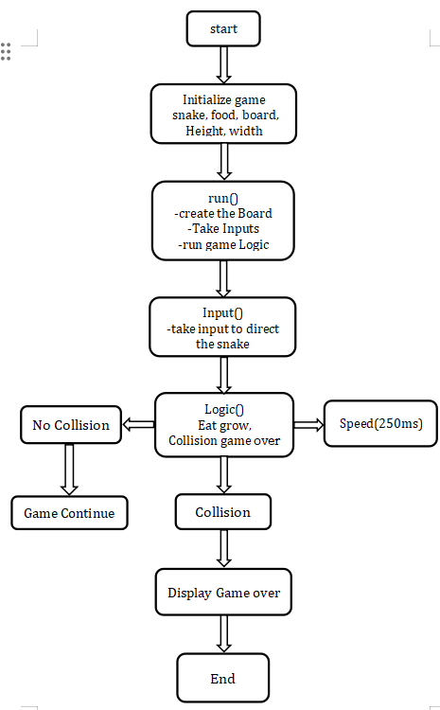
Flowchart

Slide 6
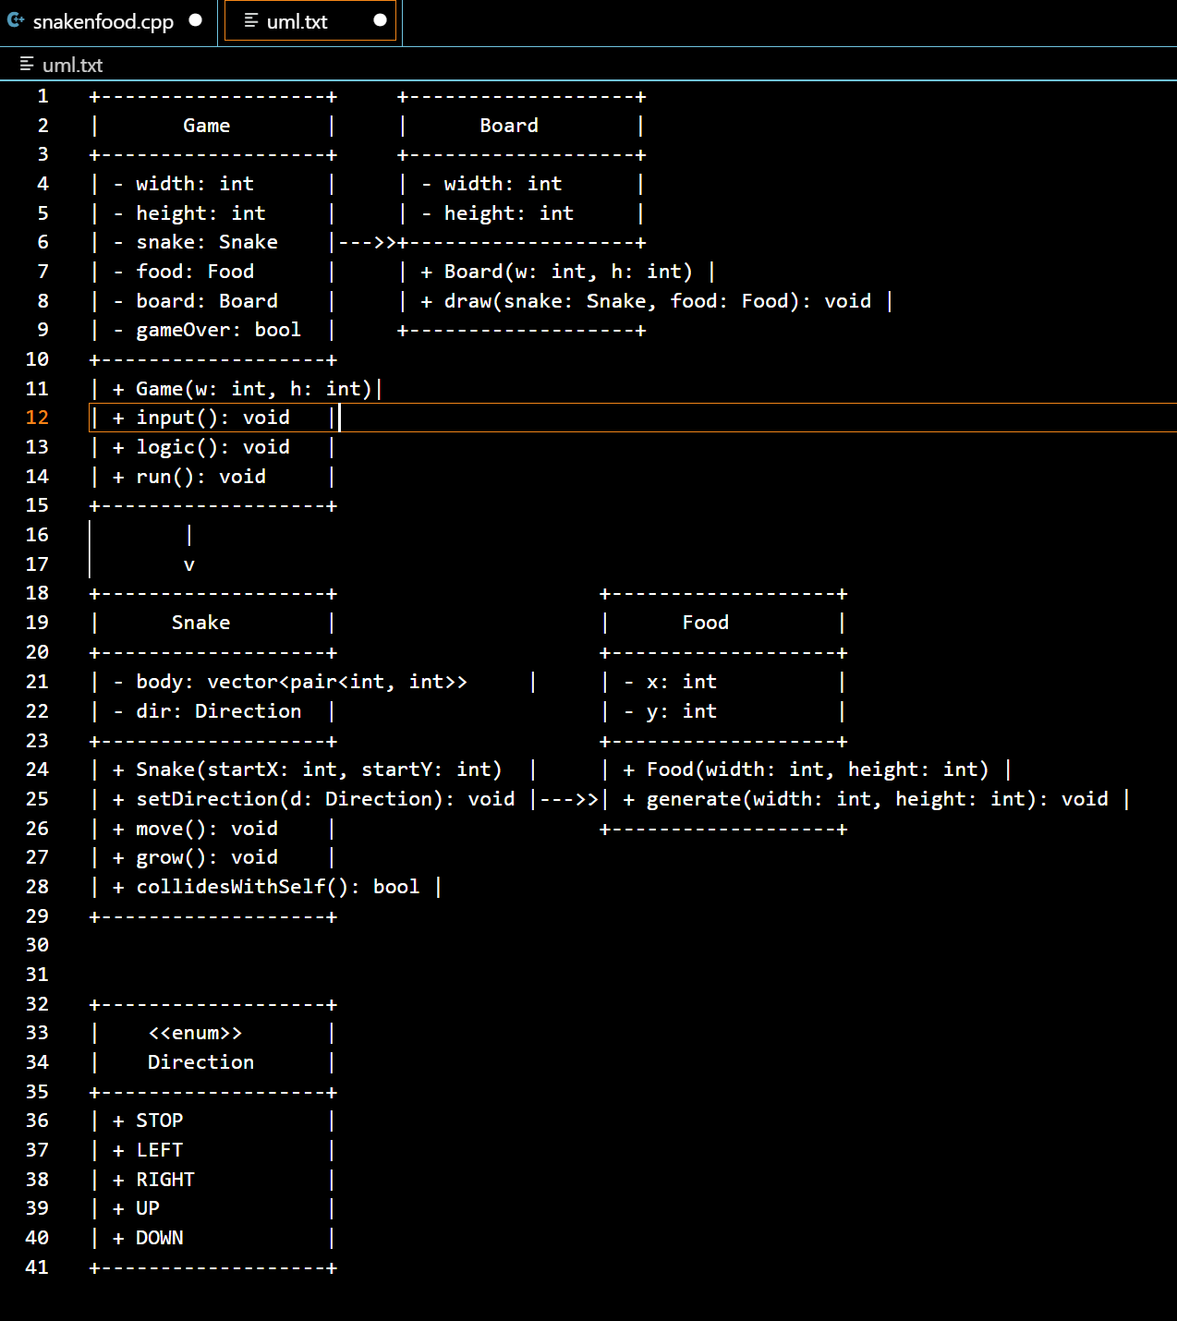
UML DIAGRAM

Slide 7
FEATURES OF OOPS
Classes and Objects: Classes define blueprints for creating objects. In the Snake game, classes like Snake, Food, Board, and Game encapsulate related data (attributes) and behaviors (methods).
Encapsulation: Encapsulation bundles data (attributes) and methods that operate on the data together. For example, the Snake class keeps track of its body segments (body) and movement logic (move(), grow(), etc.) internally.
Abstraction: Abstraction focuses on hiding complex implementation details and exposing simpler interfaces. In the game, methods like input(), logic(), and draw() provide clear ways to interact with and control the game without worrying about internal complexities.
Inheritance: Inheritance allows new classes (derived classes) to reuse and extend the behavior of existing classes (base classes). While not explicitly shown, you could extend the game with different types of snakes or food that inherit common behaviors.
Polymorphism: Polymorphism enables objects of different types to be treated as instances of a common superclass. This flexibility simplifies code and supports handling various game entities uniformly.
Modularity: Modularity divides the game into smaller, manageable parts (classes), each responsible for specific aspects of the game. This approach makes the code easier to understand, modify, and maintain.
Encapsulation and Access Control: Access specifiers (public, private, protected control how data and methods are accessed and modified. Private attributes ensure that data is only manipulated through designated methods, enhancing data security and preventing unintended changes.

Slide 8
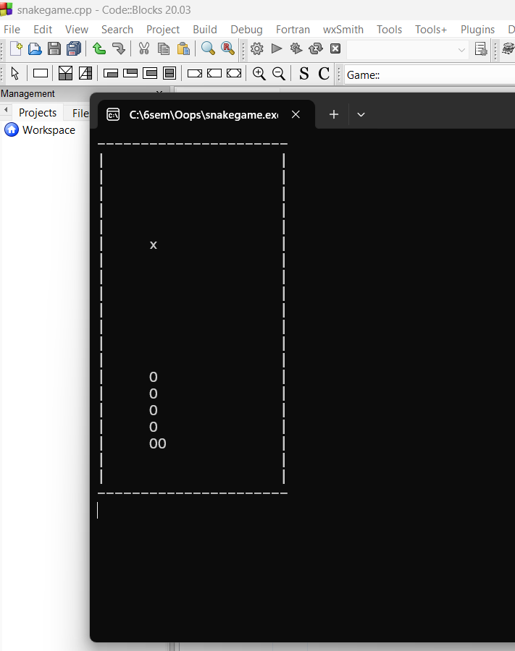
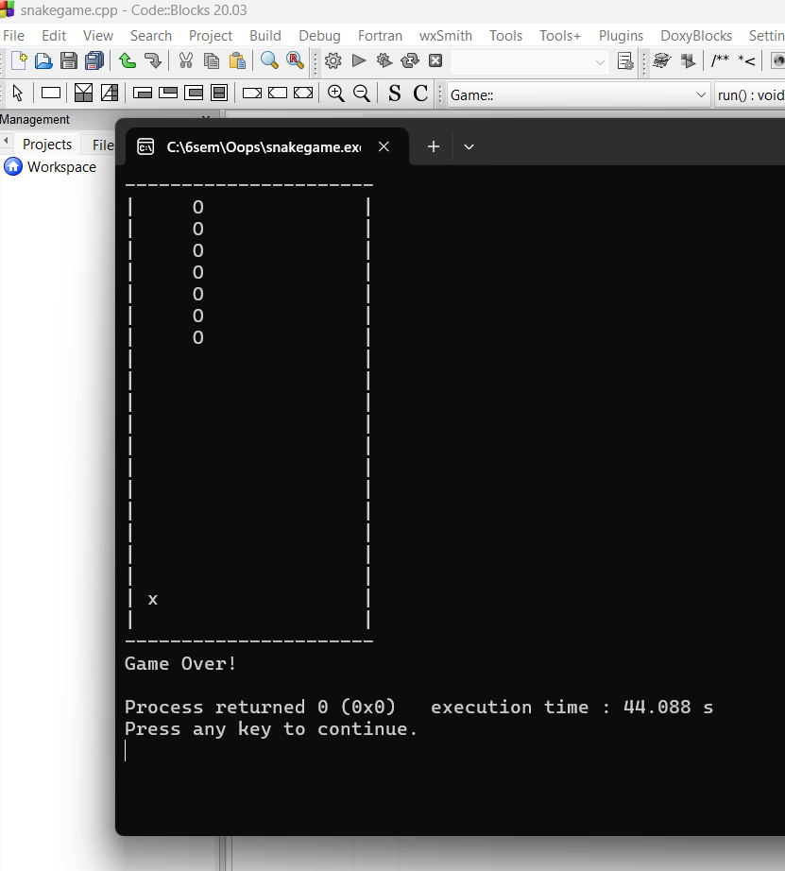
RESULTS

Slide 9
CONCLUSION
In this C++ project, we've used Object-Oriented Programming (OOP) principles to build the Snake game. By creating classes like Snake, Food, Board, and Game, each with its own responsibilities, the code becomes easier to manage and expand. OOP helps in keeping things organized and allows us to add new features without rewriting everything from scratch. Encapsulation, another OOP concept we've used, keeps data and functions within their own classes, making the code more secure and less prone to errors. Overall, OOP has helped us develop the Snake game efficiently and effectively

